Slide 1
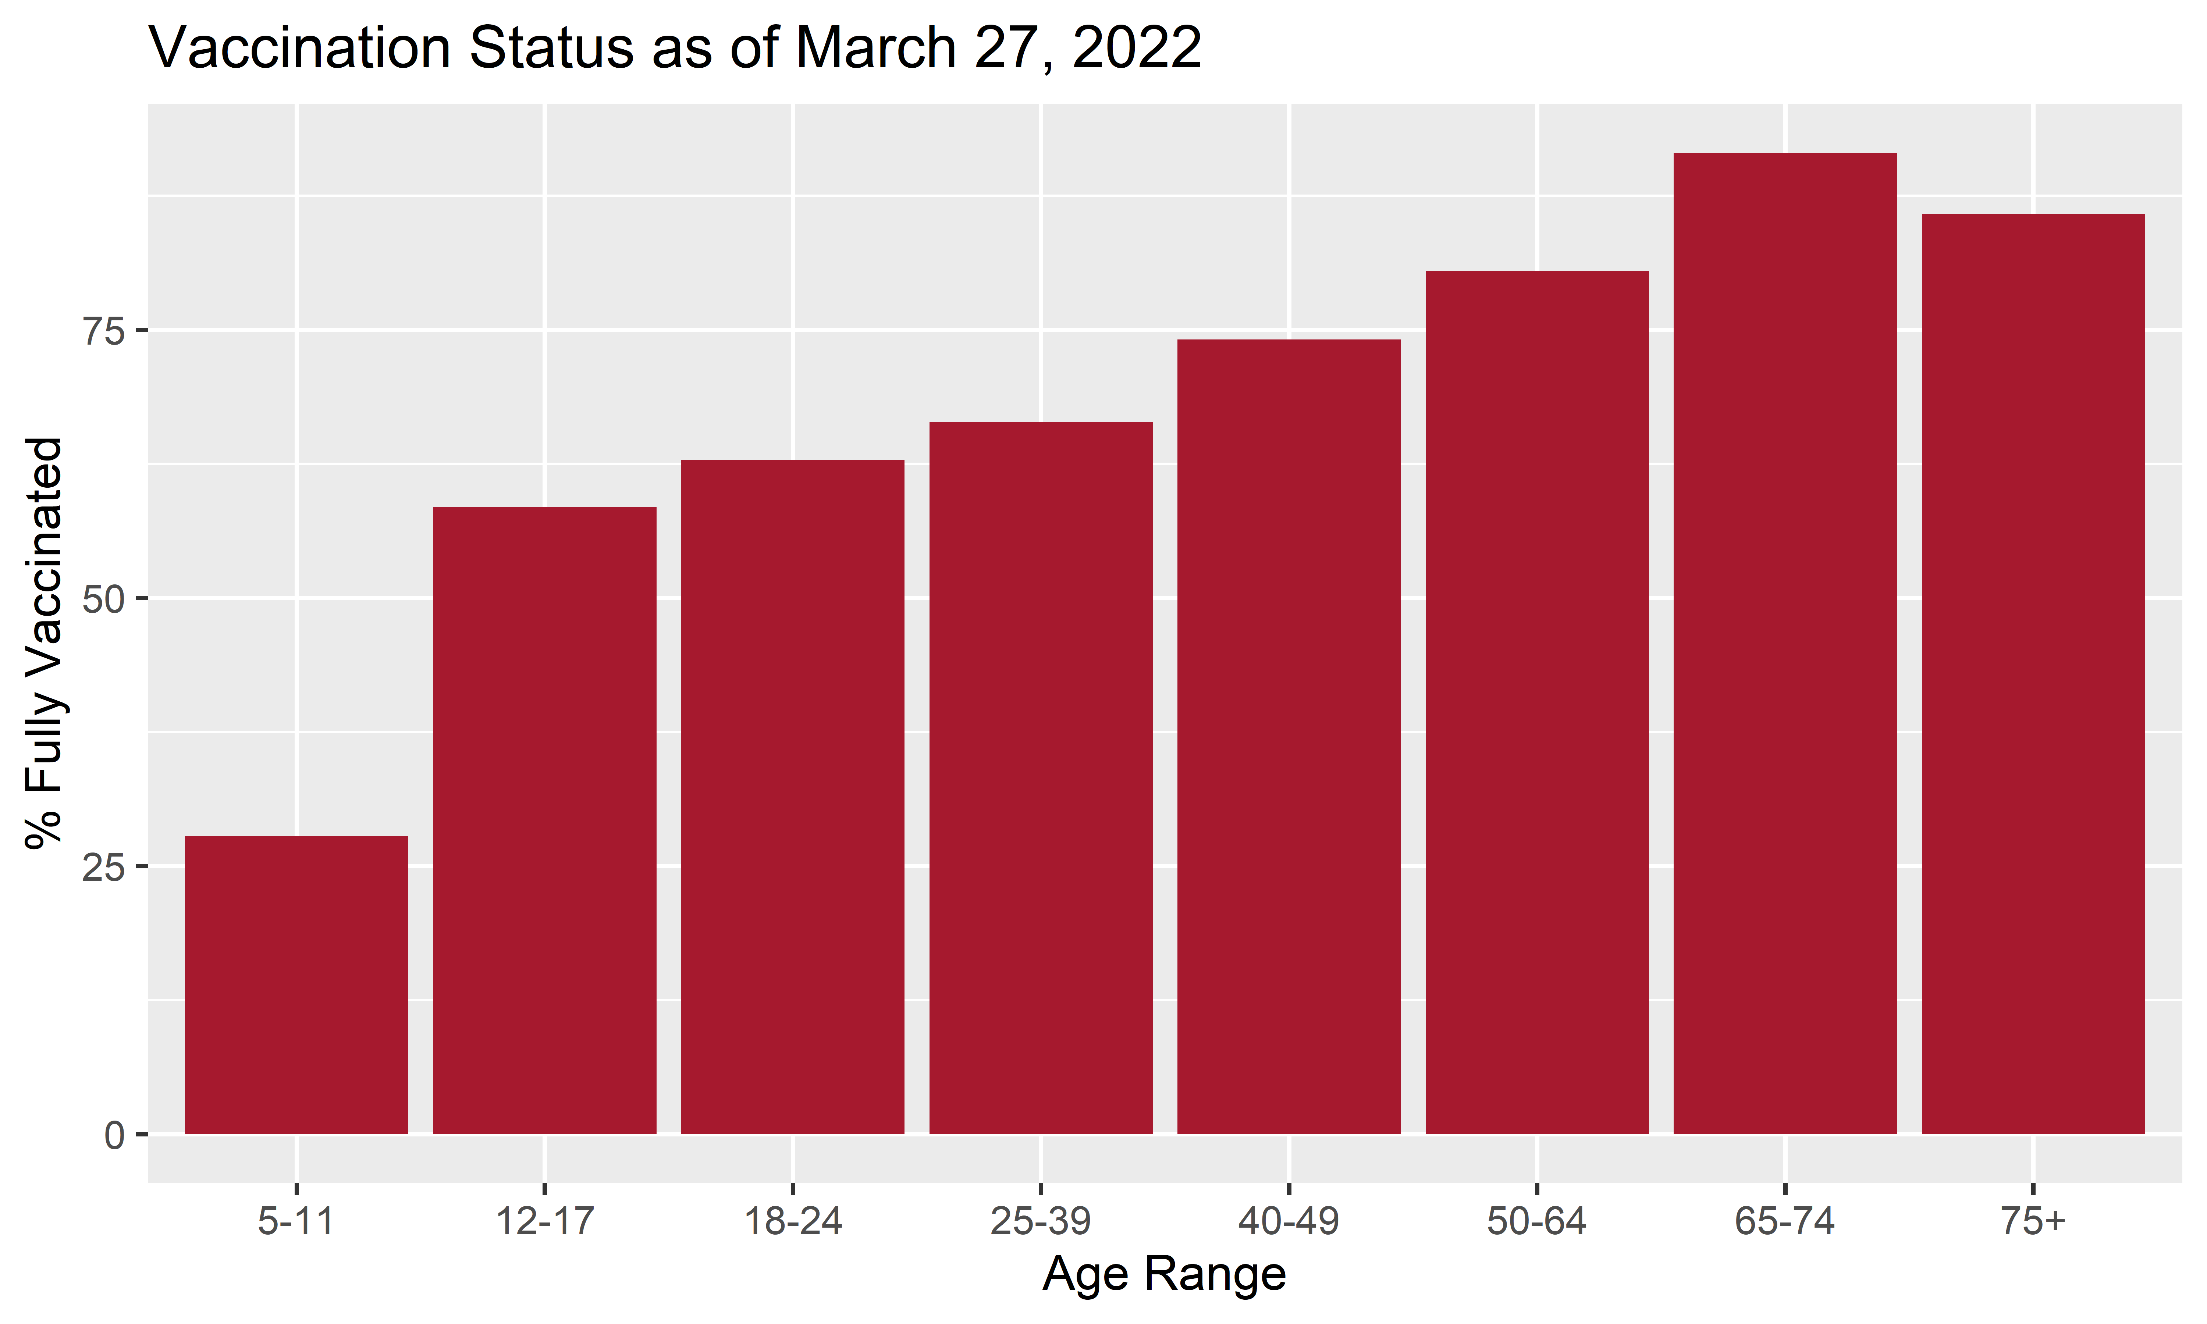
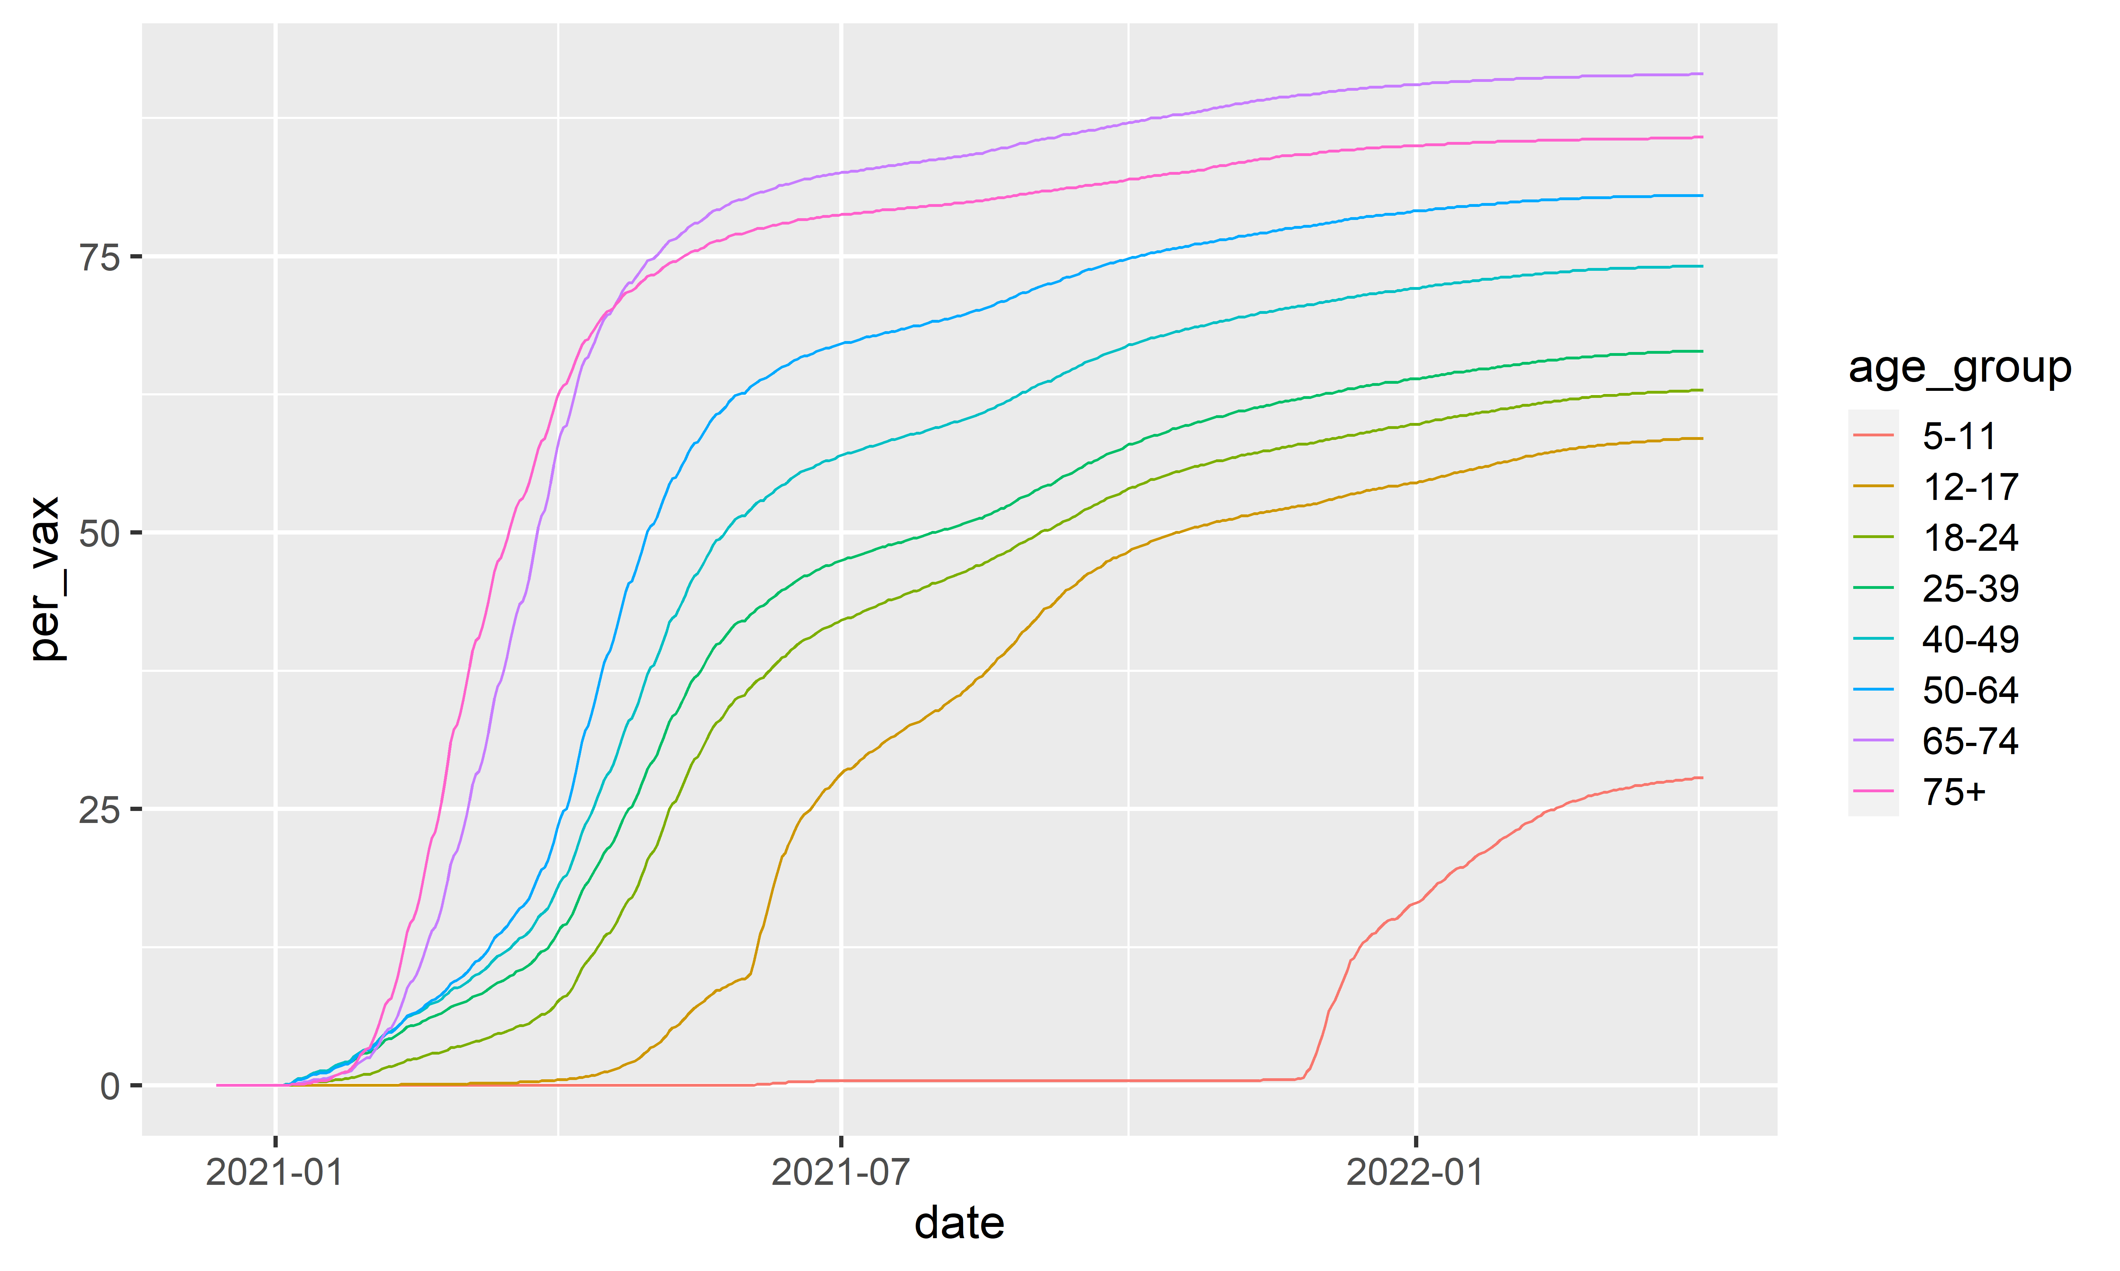
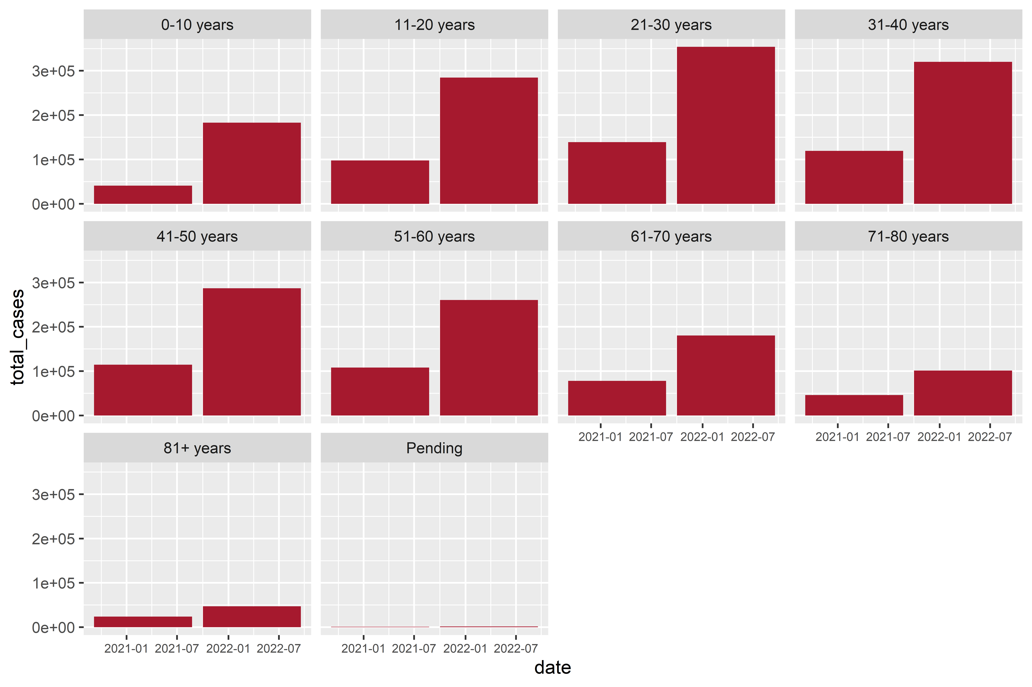


Correlation Between COVID Cases and Vaccination Status Among Different Age Groups in the U.S.
MiKayla Bolduc, Shelby Pankratz
Biosciences Department, Minnesota State University Moorhead, 1104 7th Avenue South, Moorhead, MN 56563
Abstract
COVID-19 vaccinations in the U.S. first became available to select populations, such as the elderly and immunocompromised, back in June 2020, right after COVID-19 was declared a pandemic in March. Fast forward to present day where vaccinations are available to everyone, along with the development of a booster shot. However, since then, vaccines have become a very controversial topic. The COVID-19 vaccines were the fastest vaccines to get approved for use. This has led to many people wondering, how effective are these vaccines. In this project, we will be doing an exploratory data analysis on the relationship between the number of COVID-19 cases and the number of people vaccinated. This will help to show the effectiveness of the vaccine. We will be using data from COVID Data Tracker, which is a website managed by the CDC, to look for relationships between positive COVID-19 cases and vaccination status among different age groups. We will be looking at the whole population of the U.S. to get more accurate information on the effectiveness of the COVID-19 vaccine. If the vaccine is effective, we should see that as the number of vaccinated people goes up, the amount of COVID-19 cases will go down.
Results
Discussion
Vaccination rates among all age groups, except for 75+, increased dramatically until the rates plateaued around May/June 2021
There was
Figure 1. Percent of age groups that are fully vaccinated as of March 2022
Introduction
- Observed data sets of age groups, vaccination status, and number of COVID cases in the U.S. - Compared the correlation between vaccination status and number of COVID cases in the U.S. - Looked at the rates of vaccination status among different age groups in the U.S.
Methods
COVID data: Cases
1. Go to https://www.tn.gov/health/cedep/ncov/data/downloadable-datasets.html
2. Scroll to the "Daily Age Group Outcomes" download and click
3. Click on "Show in folder"
4. Copy data set
5. Paste in data folder (Public_Dataset_Age_1_)
COVID data: Vaccination Status
1. Go to https://data.cdc.gov/Vaccinations/COVID-19-Vaccination-Demographics-in-the-United-St/km4m-vcsb
2. Scroll to "View Data"
3. Click on the Export Tab
4. Click on CSV
5. Save to data folder (COVID_19_Vaccination_Demographics_in_the_United_States_National_1_.csv)
- Print both data sets into an Rscript in R
- Filter data set to get the variables that are needed for this project
- Graph the data sets
Figure 2. Percent of age groups that are fully vaccinated as of March 2022 displayed in a line graph
Evaluate this poster
Presentation ID: FILL THIS IN
Scan the QR Code or go to:
https://bit.ly/sac2022-eval
Figure 3. Total COVID-19 cases among age groups from December 2021 to March 2022

